Slide 1
Mid / Late Summer
Bore into trees
Lay eggs
Hatch & Grow in the trees
Construction of chambers (to overwinter)
Adults
Death of Trees
Bark Beetles
Infect Tree(s)
Spread to Forest
Stops
Contains
Preventive treatments
Regular Inspections

Slide 2
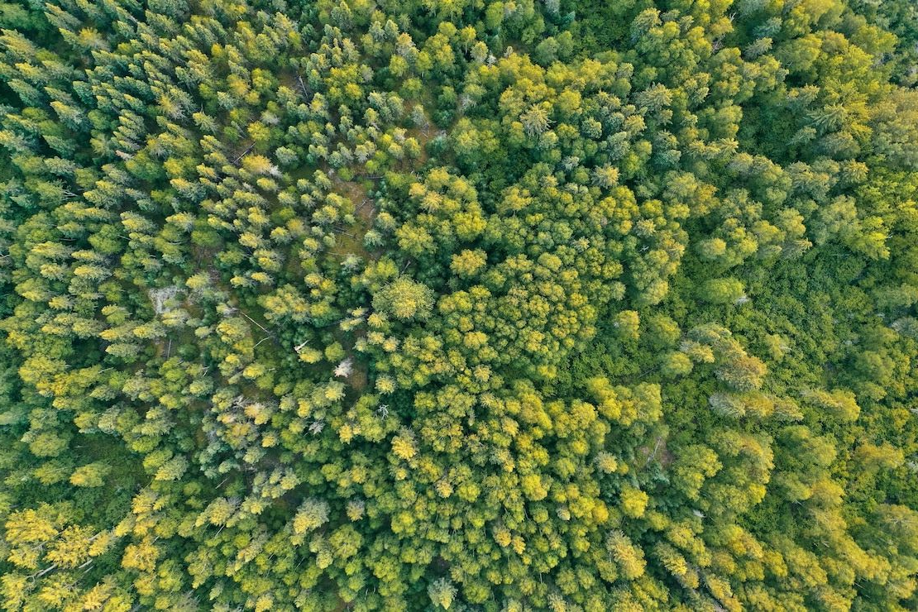
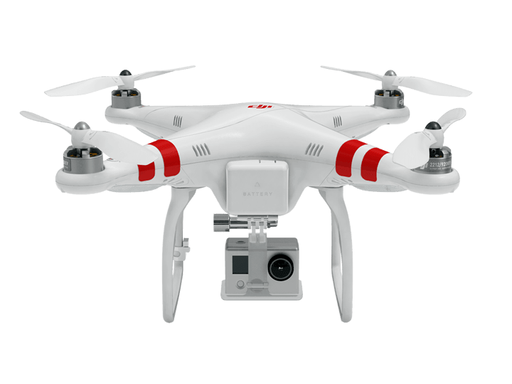
Area inspected

Slide 3
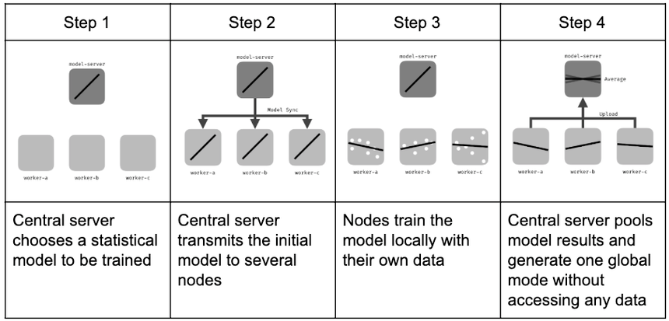
https://en.wikipedia.org/wiki/Federated_learning

Slide 4
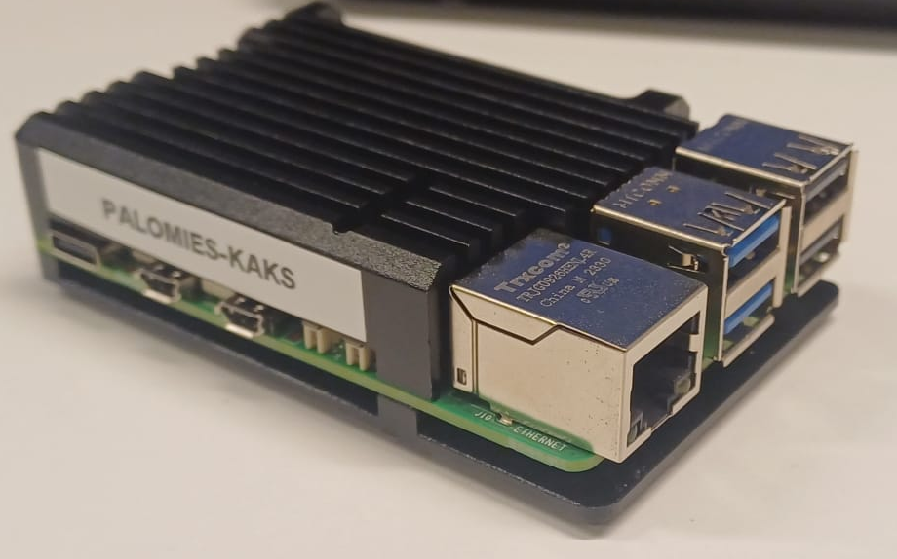

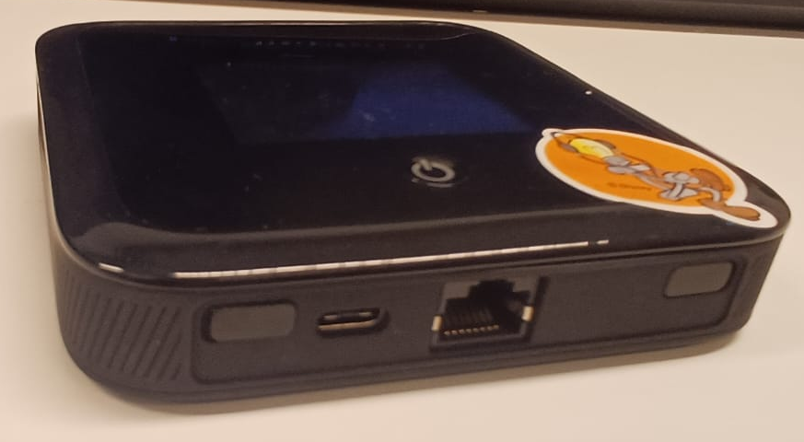
Python program / MQTT Broker
3. Models updates
4. Modification of the model after the analyse of the datas
Python program / MQTT Broker
6. Send improved model after observation
2. Reception of the updated model
8. Modification of the model.
1. Send updated model
7. Reception of modified models
2. Reception of the updated model
6. Send improved model after observation
3. Models updates
Send / Reception of datas through WiFi (JSON)
4. Modification of the model after the analyse of the datas

Slide 5
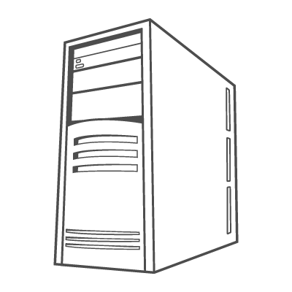

3. Models updates
4. Images are captured by the camera
5. Send photos
7. Send improved model after observation
2. Reception of the updated model
6. Modification of the model after the analyse of the datas
9. Modification of the model.
1. Send updated model
8. Reception of modified models
2. Reception of the updated model
3. Models updates
4. Images are captured by the camera
6. Send improved model after observation
5. Send photos
Send / Reception of datas through 5G (JSON)
6. Modification of the model after the analyse of the datas

